Slide 1
Dumb AI
Sometimes really simple approaches actually work
Bob Marinier

Slide 2

My Daughter got this annoying puzzle game
From the back of the box:
“Millions of possibilities, one single solution. Reconstruct the 9 piece puzzle in such a way to make all the sides match.”

Slide 3
Size of the Problem
9*4 | 8*4 | 7*4
6*4 | 5*4 | 4*4
3*4 | 2*4 | 1*4
9 cards, each with 4 orientations
9! * 4⁹ = 95,126,814,720 possible card configurations
There are at least 4 solutions, since the entire board has 4 orientations

Slide 4
I’m too lazy Busy to solve this by hand
What approaches could I use?
Could cast it as a search problem and use A*
Constraint satisfaction problem
…who has time for that? (People without kids, probably.)

Slide 5
Dumb Approach
Pretty much the same as how I was doing it by hand:
Place a random card at a random orientation
Find another random card that matches it (trying each rotation in random order)
Repeat left to right, top to bottom, until stuck or solved
If get stuck, start over
Note:
No history – nothing to avoid repeating bad solutions, no guarantee will terminate
No heuristics – e.g., not putting the one card with no match on the edge
Even dumber than brute force, which would at least be systematic
Since we check after placing each card, we are effectively pruning the space

Slide 6
Methodology
It worked! Appeared to return pretty much immediately
But maybe I’m getting lucky? Let’s gather some stats
One attempt: try up to 5000 times to solve the problem
If solve it, then done
Try 5000 attempts and get stats on number of successes, timing, etc.

Slide 7
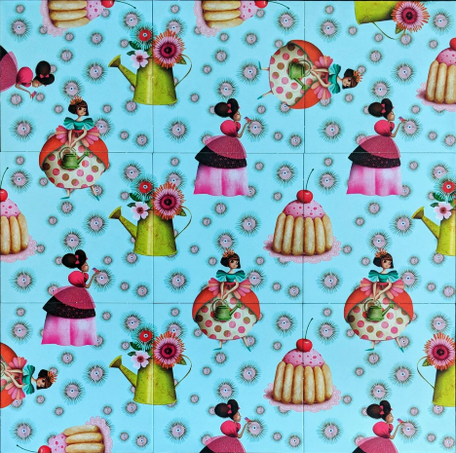
Results
Solved 5000 of 5000
Solve steps:
Min: 1
Avg: 602.6416
Max: 4427
Solve time (ms):
Min: 0
Avg: 1.5282
Max: 31

Slide 8
Maybe Dumb AI can be a Smart Choice…
Uses constant memory – may be appropriate for embedded systems, etc.
Highly parallelizable
Despite the lack of guarantees, often very fast (even with minimal optimizations in Java)
Don’t need to be an AIE to do this

Slide 9
Ok, but that problem was easy
Additional problems tried:
Snakes and Ladders: find min moves to goal
N-Queens: find any solution
Traveling Salesman: find shortest path

Slide 10
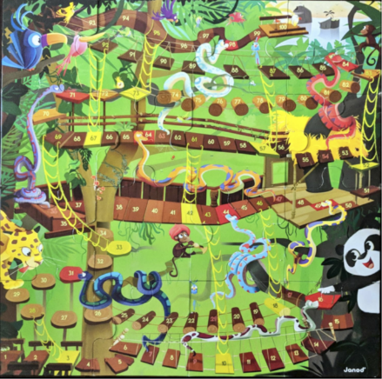
Snakes and Ladders Results
Approach: Just play the game repeatedly and see what the shortest solution found is
Solved 5000 of 5000
Solve steps:
Min: 4
Avg: 26.2902
Max: 140
Solve time (ms):
Min: 0
Avg: 0.003
Max: 15
Best solution: (quality = 0.25) [2, 5, 4, 6]

Slide 11
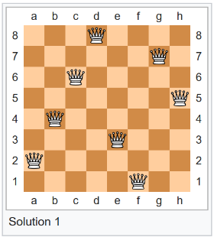
n Queens
Place n queens on an nxn chessboard such that no queen is attacking any other queen
8 Queens has 92 solutions, or 12 if you eliminate symmetric solutions
1 of 12 solutions, from
https://en.wikipedia.org/wiki/Eight_queens_puzzle

Slide 12
Size of the Problem and SMART Approaches
Simple trick is to constrain each queen to a single column: n^{n} combinations
If just want to find a solution, can directly construct one with no search
But I’m using this problem to determine how well this approach scales
Algorithms you could use include
Brute force
Backtracking searches
Permutations
Constraint satisfaction

Slide 13
Dumb Approach
Place a queen in a random row in the first column
For the next column, randomly try rows until find one that works
Repeat until either stuck or solved

Slide 14
Results

Slide 15
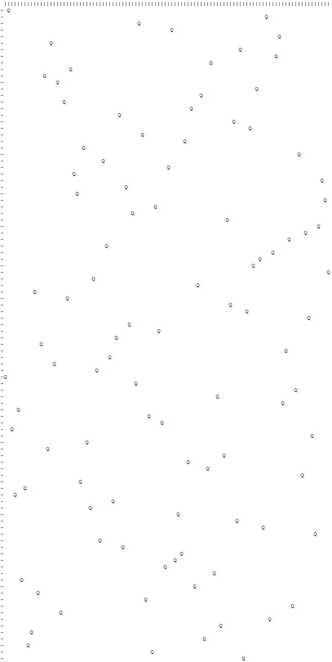
Results for 100 queens
Solved 5000 of 5000
Solve steps:
Min: 1
Avg: 547.812
Max: 4672
Solve time (ms):
Min: 0
Avg: 223.097
Max: 1984

Slide 16
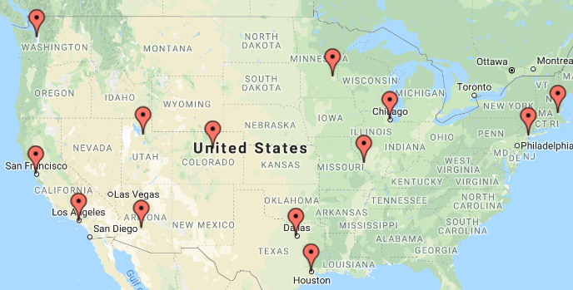
Traveling Salesman
Starting and ending at a given city, find the shortest path that visits each city exactly once
This problem instance taken from https://developers.google.com/optimization/routing/tsp
13 cities, starting and ending in New York
Optimal distance: 7293 miles

Slide 17
Actual Data
# Cities city_names = ["New York", "Los Angeles", "Chicago", "Minneapolis", "Denver", "Dallas", "Seattle", "Boston", "San Francisco", "St. Louis", "Houston", "Phoenix", "Salt Lake City"] # Distance matrix dist_matrix = [ [ 0, 2451, 713, 1018, 1631, 1374, 2408, 213, 2571, 875, 1420, 2145, 1972], # New York [2451, 0, 1745, 1524, 831, 1240, 959, 2596, 403, 1589, 1374, 357, 579], # Los Angeles [ 713, 1745, 0, 355, 920, 803, 1737, 851, 1858, 262, 940, 1453, 1260], # Chicago [1018, 1524, 355, 0, 700, 862, 1395, 1123, 1584, 466, 1056, 1280, 987], # Minneapolis [1631, 831, 920, 700, 0, 663, 1021, 1769, 949, 796, 879, 586, 371], # Denver [1374, 1240, 803, 862, 663, 0, 1681, 1551, 1765, 547, 225, 887, 999], # Dallas [2408, 959, 1737, 1395, 1021, 1681, 0, 2493, 678, 1724, 1891, 1114, 701], # Seattle [ 213, 2596, 851, 1123, 1769, 1551, 2493, 0, 2699, 1038, 1605, 2300, 2099], # Boston [2571, 403, 1858, 1584, 949, 1765, 678, 2699, 0, 1744, 1645, 653, 600], # San Francisco [ 875, 1589, 262, 466, 796, 547, 1724, 1038, 1744, 0, 679, 1272, 1162], # St. Louis [1420, 1374, 940, 1056, 879, 225, 1891, 1605, 1645, 679, 0, 1017, 1200], # Houston [2145, 357, 1453, 1280, 586, 887, 1114, 2300, 653, 1272, 1017, 0, 504], # Phoenix [1972, 579, 1260, 987, 371, 999, 701, 2099, 600, 1162, 1200, 504, 0]] # Salt Lake City

Slide 18
Problem Complexity
NP-hard: Problem gets exponentially more difficult as size increases
(n−1)!/2 possible paths = (13-1)!/2 = 239,500,800
I only encoded this one instance of the problem, but I since found a library of problem instances; if someone is interested they can explore that
https://comopt.ifi.uni-heidelberg.de/software/TSPLIB95/

Slide 19
Dumb Approach
Visit cities in random order (always starting and ending in New York)
There is no step 2

Slide 20
Results
Solved 0 of 5000
Solve steps:
Min: 5000
Avg: 5000.0
Max: 5000
Solve time (ms):
Min: 0
Avg: 1.4218
Max: 16
Dist: 9598 New York -> Houston -> Dallas -> Denver -> Phoenix -> Seattle -> Los Angeles -> Salt Lake City -> San Francisco -> Minneapolis -> Chicago -> St. Louis -> Boston -> New York
Optimal distance: 7293

Slide 21
So I let it run 10x longer…
Solved 1 of 5000
Solve steps:
Min: 8732
Avg: 49991.7464
Max: 50000
Solve time (ms):
Min: 0
Avg: 14.156
Max: 47
Dist: 7293 New York -> Boston -> Chicago -> Minneapolis -> Denver -> Salt Lake City -> Seattle -> San Francisco -> Los Angeles -> Phoenix -> Houston -> Dallas -> St. Louis -> New York

Slide 22
Conclusion
Is this even AI?
Do you really need a smart AI solution?
Dumb approaches worked better than I expected, and they were so easy to implement
Dumb AI
Doesn’t need an AIE or special skills, very quick and easy to implement
Uses constant memory – may be appropriate for embedded systems, etc.
Highly parallelizable
Despite the lack of guarantees, often very fast (even with minimal/no optimizations in Java)
Often has any-time property (e.g., Snakes and Ladders and TSP has this property)
For most problems, there are probably lots of heuristics that could be applied on top of the dumb solution
https://github.com/marinier/dumb-ai

